Slide 1
ReturNate
Allie Gardiner, Ben Stanelle, Mohammed Shihabeddin, Donna Safaddin, Henry Le

Slide 2
Possible Competitors
Amazon
eBay
Because these are two of the longest running and largest companies for online shopping and shipping, being able to grab customers from them would require large innovation

Slide 3
Companies to Collaborate With
They are clients to B-Stock, an app that liquidates purchases and returns in large quantities, so it is possible to turn returns back into profits.
These clothing companies can serve as good partners for physical store purchases
Online shoppers can visit these stores for returns or try-ons
Amazon
Walmart
Best buy
Macy’s
JCpenney
Kohls

Slide 4
Where will we operate?
United States due to it having one of the highest amounts of online purchases and returns.

Slide 5
Our Domain
Clothing collection and distribution.
We work with collaboration with outlets that give out the clothing to people that really need them
ReturNate will keep records of the number of the beneficiary people
We use "modest" transportation that consists of two pickup trucks (Ford F-150 or Chevy Silverado 1500
For the time being, the company have no storage, so ReturNate tries to deliver the available clothing as soon as they are received
Notes:
Donna Safaddin

Slide 6
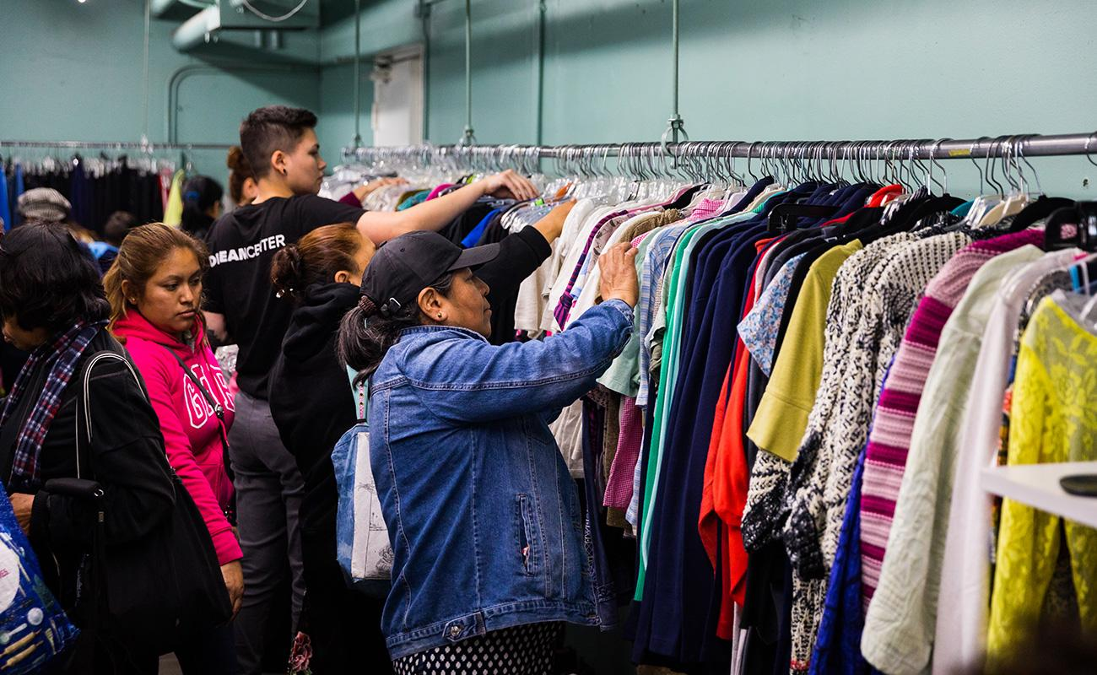
Our Why
Imagine by Dream Center
Helping people in need
Reducing waste
Our Needs:
Working relationships with the fashion stores that sell and receive the returned clothes
Working relationship with the distribution centers/charities
A couple of trucks that would be much of a help in picking up and handing the materials
Storage facility
Notes:
Donna Safaddin

Slide 7
Our Services
Online apparel returns suffers due to “size fitting”, there are many fit-apps that determine if a clothing purchase will work. We plan on using such apps and resources.
If partnering with a physical store is possible, we can provide customers a chance to try-on the items physically near their location before making purchase, nullifying a possible return, and possibly leading to interests in other store purchases.
We have to make our refund policy clear, this can be improvised in some ways (not clear yet), this is how you keep a buyer into a constant customer.

Slide 8

Our Mission
Image by DAWA Solutions Group
Encourage clothing companies to donate their unused fabrics and clothes by offering tax deductions
Repurpose the clothes and donate them to poor areas, orphanages, and third world countries
We will reduce clothings ending up in landfills
Help the less fortunate
Promote clothing companies to donate rather than throw away returned clothes
Encourage the idea of physical purchases to keep these businesses thriving

Slide 9
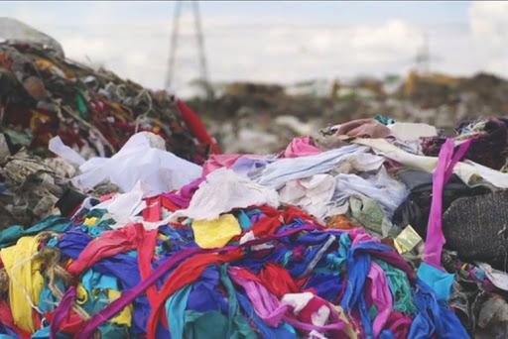
Sticky Statistics
Image by TakePart
3.5 billion products are returned every year in the US alone
Only 20% of these products are actually defective
In 2018, Burberry burned $9.8 million worth of returned clothing
The EPA (US Environmental Protection Agency) estimated the recycling rate for all textiles to be only 15.2 percent in 2017.

Slide 10
•References
https://www.practicalecommerce.com/the-growing-problem-of-customer-returns
https://www.cnbc.com/2019/01/10/growing-online-sales-means-more-returns-and-trash-for-landfills.html
https://www.prnewswire.com/news-releases/consumers-to-return-half-of-online-clothing-purchases-this-holiday-season-300760466.html
https://risnews.com/solving-problems-around-online-returns-store
https://www.fastcompany.com/90301638/your-online-shopping-has-a-startling-hidden-cost
https://chainstoreage.com/technology/survey-apparel-has-an-online-returns-problem
https://www.shopify.com/enterprise/ecommerce-returns
https://www.bbcearth.com/blog/%3Farticle%3Dyour-brand-new-returns-end-up-in-landfill/
https://www.cbc.ca/radio/thecurrent/the-current-for-dec-12-2019-1.5393783/it-s-pretty-staggering-returned-online-purchases-often-sent-to-landfill-journalist-s-research-reveals-1.5393806
https://www.epa.gov/facts-and-figures-about-materials-waste-and-recycling/textiles-material-specific-data
Images- https://www.dreamcenter.org/outreach/ https://www.dawasg.com/company/mission-vision-and-values/ http://www.takepart.com/video/2015/05/29/clothes-trash-landfill/

